Slide 1






.
Qt в образовании
Сети
и
Интегрирова-
ние Веба
Notes:
This lecture covers networking with Qt – ranging from QtWebKit, network access classes such as QNetworkAccessManager and QFtp, to sockets for TCP (including SSL) and UDP.
Recommended reading before this lecture:
http://doc.trolltech.com/qq/qq26-webplugin.html
http://doc.trolltech.com/qq/32/qq32-webkit-protocols.html
http://doc.trolltech.com/4.6/network-fortuneserver.html

Slide 2



© 2010 Nokia Corporation и её дочерние компании.
Закрытые Материалы Курса Qt в Образовании предоставлены по условиям Лицензионного Соглашения Creative Commons Attribution-Non-Commercial-Share Alike 2.5..
Полный текст лицензии доступен здесь: http://creativecommons.org/licenses/by-nc-sa/2.5/legalcode.
Nokia, Qt и логотипы Nokia и Qt являются зарегистрированными марками Nokia Corporation в Финляндии и других странах по всему миру.

Slide 3

Сети в Qt
Модуль QtWebKit предоставляет полноценный веб-рендерер, движок JavaScript и многое другое
QNetworkAccessManager предоставляет интерфейс для посылки запросов и получения ответов по сети
QFtp реализует клиентскую сторону ftp
QTcpSocket и QTcpServer предоставляют сокеты TCP
  QSslSocket предоставляет зашифрованные сокеты TCP
QUdpSocket предоставляет доступ к сокетам UDP
Notes:
Qt provides networking at many levels. When discussing networking stacks, one often discusses the levels from the physical wire, through protocols and details all the way to the final user application.
Much of this can be seen in Qt as well.
At the application level, Qt provides the QtWebKit module. It contains a full web renderer with JavaScript capabilities and more
Just underneath the browser follows the QNetworkAccessManager which lets you send requests and receive replies over the network.
The QFtp class implements and ftp client.
Under these classes we find the sockets – QUdpSocket, QTcpSocket and QTcpServer.
For your security needs, the QSslSocket provides encrypted sockets.

Slide 4

QtWebKit
Основан на открытом движке
WebKit
WebKit является основой для
браузера Safari от Apple, и множества других браузеров
Apple изначально основал WebKit на KHTML и KJS из KDE
KDE построен на технологии Qt
Notes:
The QtWebKit module is a Qt port of the Open Source WebKit engine used in Apple's Safari browser.
This rendering engine is now being used in numerous browsers such as Google Chrome, Safari, Android's browser, reKonq, etc
The inclusion of WebKit into Qt can be said to close the circle. Apple built WebKit using the KHTML and KJS modules of KDE, and KDE is built on Qt technology.
Continues

Slide 5
Что такое QtWebKit
Движок для отрисовки Web
Движок JavaScript
Классы для интегрирования Qt и веб-содержимого для создания смешанных приложений
Notes:
Looking at WebKit, it is not a web browser as such, even if it can be used to build one
It is a rendering engine – it can render HTML to what the user expects to see on screen
It also contains a JavaScript engine for web pages executing on the client
Qt's integration of WebKit includes classes for integrating Qt into the web, and the web into Qt. The idea behind this is to be able to create hybrid applications
Continues

Slide 6
Способности визуализации WebKit
HTML 4.01, и частично HTML 5
  2D полотно
  Проигрывание аудио и видео
  Оффлайн приложения
  Web workers, хранение и базы данных SQL
CSS 1+2, и частично CSS 3
  Фоны и рамки
  Шрифты
  Преобразования 2D и 3D
  Переходы и анимации
Notes:
The WebKit module can handle most standards expected from a modern browser. For instance:
- support for HTML 4.01, and partial support for HTML 5.
In HTML 5, the 2D canvas, audio and video playback, offline applications, webworkers (threads), storage and SQL database access are supported.
- support for CSS 1 and 2, and partial support for CSS 3
In CSS 3, webkit supports backgrounds, borders and fonts, but also transformations in both 2D and 3D, as well as transitions and animations.

Slide 7
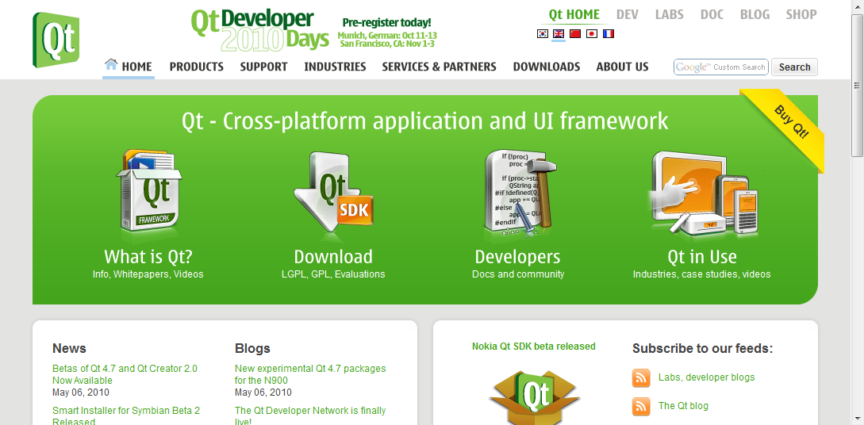
Просмотр веб-страницы
QWebView
QWebPage
QWebFrame
Notes:
When viewing a web page through the QWebView widget, you actually invoke a whole tree of objects
The web view is only a view onto a QWebPage
Each web page then consists of one or more QWebFrame objects
Continues

Slide 8
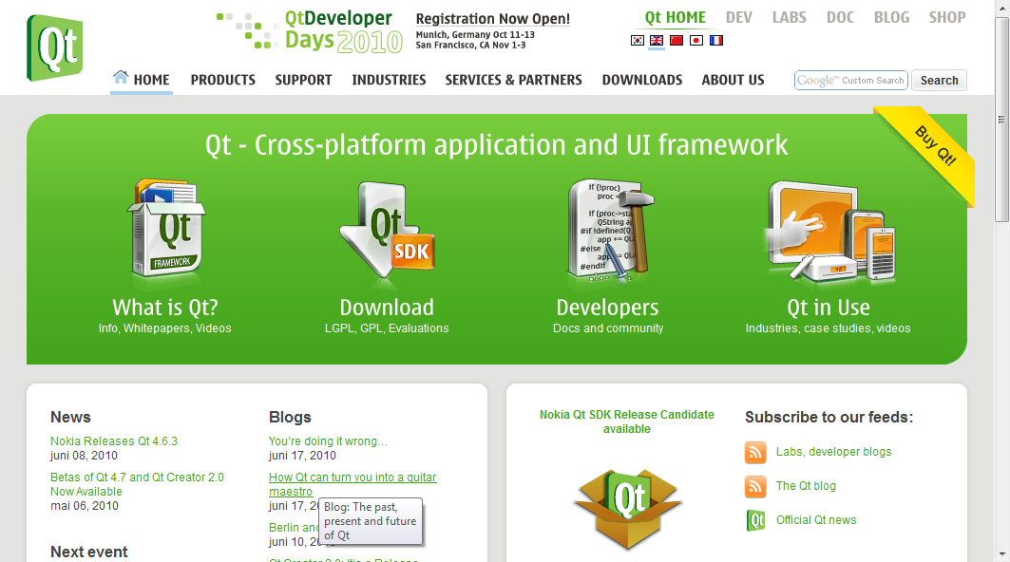
Просмотр веб-страницы
QWebView *view = new QWebView();
view->load(QUrl("http://qt.nokia.com"));
Notes:
Using the web view to show a page is simple though, simply tell it to load a URL and it handles the rest
A QWebView widget contains a fully fledged web renderer, containing the QWebPage and QWebFrames
To add functionality such as back, forward, bookmarks, address field, etc you must add widgets around the QWebView and make appropriate connections and calls

Slide 9
Смешанные приложения
Если Ваше приложение интегрировано с веб-страницей, пользователю предоставляется привычный интерфейс, а Вы можете сконцентрироваться на функциональности.
Интеграция означает
  Встраивание содержимого Qt в страницы
  Доступ к Web и JavaScript из Qt
  Доступ к Qt из JavaScript
Notes:
One key concept for QtWebKit is the ability to create hybrids between web and desktop applications
This way, you can provide your users with a familiar look and feel, and still take advantage of desktop-only technologies
QtWebKit lets you integrate the web and your application in several ways
You can embed Qt components directly in a web page
You can access the web and JavaScript from Qt
You can access Qt from JavaScript (running in the web page)
The end result is a fully integrated web and application, where parts of the application consists of web contents, while part of the web consists of application components.
Continues

Slide 10
Встраивание виджетов
Возможно интегрировать объекты QWidget в страницы HTML в качестве плагинов
Когда веб-страница содержит тег object, Qt ищет mime-тип
Mime-тип используется для опроса существующих экземпляров QWebPluginFactory
Если тип совпадает, то фабрике плагинов посылается запрос на создание виджета
Notes:
They way that you embed Qt components into your web page is to embed Qt widgets into it
QWidgets can easily be exposed to WebKit through plugins
When encountering object-tags in the HTML, Qt will look up the object's mime-type
Using the mime-type, a QWebPluginFactory will create the appropriate widget which then is placed on the HTML page
Continues

Slide 11
Интеграция QWidget
Подробный взгляд на интеграцию QCalendarWidget с веб-страницей
  Необходимый код HTML
  Фабрика плагинов
  Управление свойствами
  Активация плагинов в webkit
Notes:
We will now have a look at how to integrate a widget with a web page.
As a starting point, we will use the QCalendarWidget, as it provides useful functionality
The solution consists of a piece of HTML to request the widget
A plugin factory that can match the HTML request to the creating of the actual widget
Some code for handling properties sent from HTML to the factory
And finally, how to enable plugins in QtWebKit
Continues

Slide 12
Встраивание виджетов
Виджеты встраиваются посредством тега object
<html>
<body>
<h1>Integrated Widget</h1>
<p>
<object type="application/x-qt-calendar">
<param name="gridVisible" value="true" />
</object>
&nbsp;
<object type="application/x-qt-calendar">
<param name="gridVisible" value="false" />
</object>
</p>
</html>
Notes:
From the HTML perspective the object tags list a type which controls which widget is created
The param tags are optional. They are used to set values to properties of the embedded widget. In this example, the gridVisible property is set to true.
Continues

Slide 13
Встраивание виджетов
Объект QWebPluginFactory используется для создания виджетов из mime-типов
#include <QWebPluginFactory>
class PluginFactory : public QWebPluginFactory
{
Q_OBJECT
public:
explicit PluginFactory(QObject *parent = 0);
QObject *create(const QString &mimeType,
const QUrl &url,
const QStringList &argumentNames,
const QStringList &argumentValues) const;
QList<Plugin> plugins() const;
};
Notes:
For Qt to be able to interpret the object tag with a request for a given type to a widget, a QWebPluginFactory must be able to support the type
For this, we create PluginFactory, derived from QWebPluginFactory
It has a constructor, a create method and a plugins method.
The idea behind the plugins part is that each factory can serve several types of widgets. The Plugin list basically lists the mime-types supported by this plugin
Continues

Slide 14
Встраивание виджетов
QObject *PluginFactory::create(const QString &mimeType,
const QUrl &url, const QStringList &argumentNames,
const QStringList &argumentValues) const
{
QWidget *result = 0;
if(mimeType == "application/x-qt-calendar")
{
result = new QCalendarWidget();
for(int i=0; i<argumentNames.count(); ++i)
result->setProperty(argumentNames[i].toLatin1().constData(),
argumentValues[i]);
}
return result;
}
Notes:
The create method does the interesting work.
It ensures that the requested mime-type is correct, then creates a new widget. In this case, a QCalendarWidget
It then iterates over all arguments given (i.e. the param tags) and sets the properties of the widget accordingly.
Notice that the method returns a QObject pointer. It is important to be aware of the fact that only QWidget derived classes and QGraphicsWidget derived classes are accepted.
Continues

Slide 15
Встраивание виджетов
Перед тем, как плагины смогут быть загружены, они должны быть активированы посредством объекта представления QWebSettings
Затем, фабрика плагинов должна быть установлена на странице
QWebView view;
view.settings()->setAttribute(
QWebSettings::PluginsEnabled, true);
view->page()->setPluginFactory(
new PluginFactory(this));
Notes:
Before the plugins can be loaded, WebKit must be made aware of the plugin factory and plugin support must be enabled
Enabling the support for plugins is managed through the web settings object associated with the view
Simply set the PluginsEnabled attribute to true
We then set the plugin factory as the plugin factory for the page of the view
Continues

Slide 16
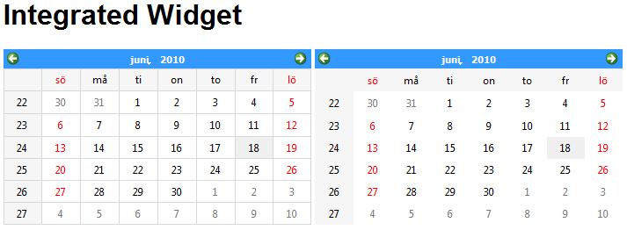
Встраивание виджетов
<html>
<body>
<h1>Integrated Widget</h1>
<p>
<object type="application/x-qt-calendar">
<param name="gridVisible" value="true" />
</object>
&nbsp;
<object type="application/x-qt-calendar">
<param name="gridVisible" value="false" />
</object>
</p>
</html>
Notes:
The final result is two QWidgets integrated on the web page, with different property settings handled through the param tags

Slide 17
Доступ к DOM из Qt
Document Object Model доступен из класса QWebElement
QWebFrame
QWebElement
QWebPage
Notes:
The DOM, Document Object Model, of any webpage being shown is available through the QWebElement class.
Each frame of a given page contains web elements that correspond to the structure of the HTML document
Using these objects, it is possible to inspect and modify the DOM of a given web page
Continues

Slide 18
Навигация по DOM
Каждый QWebFrame содержит один documentElement.
Это корневой элемент фрейма
QWebView *view = ...;
QWebFrame *frame =
view->page()->currentFrame();
QWebElement documentRoot =
frame->documentElement();
Notes:
To traverse the DOM tree, you must first locate the root element of a frame
To do that, you must find the frame
Given a web view showing the page that you're interested in, you can get the current frame through the page's currentFrame method
In most scenarios, there is only one frame. If there are several frames, you might want to use the mainFrame method, and look for your specific frame using the childFrames method in the QWebFrame returned
When you have a frame, use the documentElement to find the root element of the DOM shown in the frame
Continues

Slide 19
Навигация по DOM
Из каждого объекта QWebElement есть возможность проходить или искать
  проход
    firstChild – возвращает первый дочерний элемент
    nextSibling – возвращает следующий элемент на одном уровне с найденным дочерним
    isNull – верно если нет дочерних элементов/братьев
  поиск
    findFirst и findAll – принимает селектор CSS2 в качестве аргумента, например findAll(".class tag")
Notes:
QWebElement objects represent the structure that the HTML tags build.
From each web element, you can traverse the child elements using the firstChild and nextSibling methods. The web element returned returns true from the isNull method if there are no child elements, or the last sibling has been reached.
You can also search for specific elements. Using findFirst or findAll, you can search using CSS2 (cascading style sheets, version 2) selectors as arguments.
Using these two approaches, you can find the specific elements that you are looking for.
Continues

Slide 20
Исследование DOM
Каждый объект QWebElement содержит информацию о текущем элементе DOM
e.tagName = "A"
e.toPlainText = "Qt Road map"
e.classes = QStringList()
e.attributeNames = QStringList("href")
e.attribute("href") = "http://qt.nokia.com/developer/qt-roadmap"
<a href="http://qt.nokia.com/developer/qt-roadmap">Qt Road map</a>
Notes:
When you have located a specific web element, you can examine it
The tagName property holds the name of the tag, i.e. the first word of the tag
The toPlainText method returns the contents as plain text
You can get a list of classes that the tag belongs to using the classes property
The attributeNames and attribute methods can be used to examine which attributes are available and what they are set to
Continues

Slide 21
Изменение DOM
Можно изменить объекты QWebElements множеством путей
  encloseWith – заключает элемент в другой элемент
  setAttribute – устанавливает атрибут
  toggleClass – переключает класс
  setPlainText / setInnerXml – заменяет содержимое элемента
  setOuterXml – заменяет элемент и его содержимое
Notes:
It is also possible to modify web elements. This can be done in many ways
The encloseWith method lets you enclose the element in another element
setAttribute sets attributes
toggleClass lets you toggle whether the element belongs to a class or not
The setPlainText / setInnerXml methods lets you replace the contents of the element
The setOuterXml method replaces the element itself and its contents

Slide 22
Интеграция JavaScript
Можно интегрировать объектную модель Qt и JavaScript
  Выставляйте QObjects в JavaScript
  Запускайте JavaScript из Qt
Отлично для смешивания Qt и веб-содержимого
Notes:
One part of the integration between the web page contents and Qt, is the ability for JavaScript to interact with Qt objects
It is possible to expose QObjects to JavaScript, and it is possible to trigger JavaScripts from Qt
This makes it easy and convenient to mix Qt and web contents
Continues

Slide 23
Выставление QObjects
После выставления QObject в JavaScript, свойства и слоты станут доступными
Вызовите addToJavaScriptWindowObject на QwebFrame чтобы добавить объект на фрейм
После загрузки новой страницы, ссылки на объект будут удалены и будет испущен сигнал javaScriptWindowObjectCleared
  Добавьте объекты из слота, подключенного к этому сигналу
view->page()->currentFrame()->
addToJavaScriptWindowObject("helloqt", javaScriptObject);
Notes:
When you expose a QObject to JavaScript, the script will get access to properties and slots
To expose an object, call the addToJavaScriptWindowObject method of a frame
This lets you add a given object under a given name. In the example, the object javaScriptObject will be known as helloqt on the JavaScript side
Each time a web page is loaded, all object references will be cleared. This is just to ensure that there will be no cross-site-contamination
When the references are cleared, the javaScriptWindowObjectCleared signal is emitted. By connecting this to a slot, it is possible to add the objects to the context again.
Continues

Slide 24
Доступ к QObjects
class MyJavaScriptObject : public QObject
{
Q_OBJECT
Q_PROPERTY(QString text READ text WRITE setText)
public:
explicit MyJavaScriptObject(QObject *parent = 0);
const QString &text() const;
public slots:
void setGreeting();
void setText(const QString &text);
...
};
Notes:
Looking at an object intended to be exposed to JavaScript, we make one property available and then all the public slots
This means that this object will have a text property and a setGreeting method
Continues

Slide 25
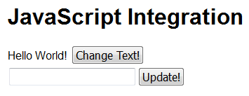
Доступ к QObjects
<html>
<body>
<h1>JavaScript Integration</h1>
<div><span id="greeting">Hello World!</span>
<button type="button" onclick="helloqt.setGreeting();">
Change Text!
</button>
</div>
<div>
<input type="text" id="textInput" />
<button type="button" onclick="helloqt.setText(textInput.value);">
Update!
</button>
</div>
</body>
</html>
Notes:
From the HTML side, the methods can be invoked from any JavaScript
In the example here, the scripts have been embedded in tags of the buttons in question
When the “change text” button is clicked, the setGreeting method is called (the slot)
When the “update” button is clicked, the setText method is called with the new text as argument
Continues

Slide 26
Запуск JavaScript
JavaScript может быть запущен, используя метод evaluateJavaScript, доступный из QWebFrame и QWebElement
Сигнал loadFinished испускается из QWebPage когда страница была загружена полностью. Это удобная точка, из которой можно запускать JavaScript
view->page()->currentFrame()->
evaluateJavaScript(QString("textInput.value=\"%1\"").arg(text));
Notes:
It is not only possible to access QObjects from JavaScript. It is also possible to trigger JavaScript from Qt
By calling the evaluateJavaScript method of a frame, the java script code is executed
Connecting to the loadFinished signal of a web page, you have a perfect trigger for executing JavaScripts

Slide 27
Интеграция JavaScript
Класс QWebPage содержит несколько protected-методов, которые должны приниматься в учёт во время интеграции JavaScript
  javaScriptAlert
  javaScriptConfirm
  javaScriptConsoleMessage
  javaScriptPrompt
  createWindow
Сигналы
  windowCloseRequested
  printRequested
Слоты
  shouldInterruptJavaScript
Notes:
When integrating JavaScript and Qt in a hybrid application, there are a number of re-implementable methods, signals and slots to be aware of
The methods javaScript* and createWindow can be re-implemented to handle alerts and messages from JavaScript
The signals windowCloseRequested and printRequested must be connected to appropriate slots for these functions to work
The slot shouldInterruptJavaScript handles JavaScripts that run for too long (i.e. might be hung)

Slide 28
Доступ к сети
Классы QtWebKit используют QNetworkAccessManager для доступа к сети
Менеджер доступа к сети предоставляет доступ к вебу без каких-либо соединений к пользовательскому интерфейсу. Он может
  управлять запросами и ответами
  кешировать веб-страницы
  cледить за механизмом “cookies”
  использовать прокси-серверы
  выступать в роли транслятора протокола
Notes:
The QtWebKit classes use the QNetworkAccessManager class to access the internet
The access manager provides access to the web without providing a user interface
It is responsible for handing requests and replies, caching, cookies, proxy settings
It can also intercept traffic and do statistics or translate protocols, etc
Continues

Slide 29
Классы для доступа к сети
QNetworkRequest
QNetworkReply
QNetworkAccessManager
QNetworkProxyFactory
QAbstractNetworkCache
QNetworkCookieJar
Notes:
When using the QNetworkAccessManager, you use multiple classes
Replies and requests are handled by the QNetworkRequest and QNetworkReply classes
The proxy management is performed using QNetworkProxyFactory
Caching uses the QAbstractNetworkCache interface
The QNetworkCookieJar handles cookies
Continues

Slide 30
Программный доступ к HTTP
Пример – скачивание файла через HTTP используя QNetworkAccessManager
QNetworkAccessManager *manager = new QNetworkAccessManager(this);
connect(manager, SIGNAL(finished(QNetworkReply*)),
this, SLOT(downloadDone(QNetworkReply*)));
manager->get(QNetworkRequest(QUrl("http://doc.qt.nokia.com/images/logo.png")));
MyClass::downloadDone(QNetworkReply *reply)
{
QImageReader reader(reply, "png");
mImage = reader.read());
emit imageChanged(mImage);
reply->deleteLater();
}
Notes:
Using the an access manager, you can do anything that the user can do via the web browser
For instance, the snippet above demonstrates how to download a file via the HTTP protocol and to parse the result
This is naive, however, as there is no error handing what so ever.
Continues

Slide 31
QNetworkAccessManager для интерфейса с другими протоколами
Создавая подклассы QNetworkAccessManager можно предоставить web-like интерфейс к любому источнику данных
Так как классы QtWebKit используют менеджер доступа к сети для доступа к сети, можно использовать их с альтернативными источниками данных
Qt Quarterly содержит пример реализации FTP браузера используя данный подход
http://doc.qt.nokia.com/qq/32/qq32-webkit-protocols.html
Notes:
By sub-classing the QNetworkAccessManager class and creating your own access manager, you can provide a web interface to any data source
For instance, you can dynamically translate an FTP session into web pages to show in a QWebView
As the QtWebKit classes use an access manager for interfacing the network, it is possible to have all traffic pass through your custom access manager

Slide 32
Перерыв

Slide 33
Протоколы
Навигация по Web использует протокол HTTP
  Hyper-Text Transfer Protocol
  Иногда зашифрованный - https
HTTP спроектирован над TCP который спроектирован над IP
Существует много других протоколов спроектированных над TCP/IP, например FTP, SMTP, POP, IMAP
HTTP, FTP, SMTP,
POP, IMAP, и др.
TCP
IP
(IPv4 и IPv6)
Notes:
When browsing the web, you usually rely on HTTP, the hyper text transfer protocol
Sometimes you encounter HTTPS, which is the same protocol, only encrypted
HTTP is built on top of TCP, which is a protocol to handle transfers of packets.
TCP in turn is built upon the IP protocol, which forms the base of the internet
There are many more protocols built on TCP/IP – FTP, SMTP, POP; IMAP, bittorrent, etc I'm sure you've encountered more.

Slide 34
FTP
Класс QFtp инкапсулирует протокол FTP
  File Transfer Protocol
FTP позволяет
  авторизоваться на серверах
  показывать список файлов
  перемещаться по файловой системе
  закачивать и скачивать файлы
Notes:
The QFtp class encapsulates the FTP protocol from the client side
FTP stands for file transfer protocol and lets you
log in
list files and directories
traverse the directory tree
download and upload files
The FTP protocol is wide spread and commonly used.
Continues

Slide 35
Скачивание файла
Чтобы скачать файл ftp.qt.nokia.com/qt/source/README используя объект QFtp, нужно предпринять следующие шаги
  connectToHost("ftp.qt.nokia.com")
  login
  get("/qt/source/README")
  close
Notes:
As an example of the FTP protocol, let's have a look at the steps involved to download a small file from the Qt Nokia ftp site.
First, you connect to a host by calling connectToHost with the server name
As this is a public ftp, we do not provide any user name nor password. It is still necessary to login though, just to get the protocol into the right state,
The next step is to download the file. That is done by calling get and provide the filename as an argument
The finished download is signaled by the done signal, and you can read all the data using the readAll method
Finally, we close the connection
Continues

Slide 36
Разделение URL
The QUrl class can be used to split a URL into its parts
ftp://ftp.qt.nokia.com/qt/sources/README
схема
хост
путь
QUrl url("ftp://ftp.qt.nokia.com/qt/sources/README");
QString host = url.host();
QString path = url.path();
Notes:
Looking at the download in more detail, lets take it from the beginning.
The URL, given as the address to the file that we want to download, can be split into parts. This is done using the QUrl class
Looking at the full url, we can tell that it uses ftp from the scheme part, the host is the name before the first / while the rest is considered the path
All these components, and more, can be extracted using the QUrl class.
Continues

Slide 37
Скачивание файла
Любая команда, запрошенная через QFtp, является асинхронной
Когда команда завершена, испускается сигнал commandFinished(int id, bool error)
  id – целочисленный id для каждой команды, возвращённый во время запроса команды, например int QFtp::close()
  error – верно, если выполнение команды закончилось ошибкой
Notes:
When we have the components of the URL that we need, we can start working with the QFtp object
Every time you tell a QFtp object to call a command, you trigger an asynchronous command
When such a command has finished, the QFtp object emits a commandFinished signal
The signal carries an id for the command in question. This id is returned when requesting each command. And an error flag, indicating whether the command was executed as expected or not.
Continues

Slide 38
Скачивание файла
Все команды могут быть запрошены одновременно
Или может быть построена простая машина состояний
void Downloader::start()
{
m_ftpState = Connecting;
m_ftp->connectToHost(host);
}
void Downloader::ftpFinished(int, bool error)
{
switch(m_ftpState)
{
case Connecting:
m_ftpState = LoggingIn;
m_ftp->login();
break;
case LoggingIn:
m_ftpState = Downloading;
m_ftp->get(file, 0, QFtp::Ascii);
break;
case Downloading:
result = m_ftp->readAll();
m_ftpState = Disconnecting;
m_ftp->close();
break;
case Disconnecting:
m_ftpState = Inactive;
break;
}
}
Notes:
In theory, all commands can be requested in one go – however that can cause a minor chaos if one command in the middle of a sequence fails.
A better approach is to build a simple state machine.
In the example code here, the m_ftpState variable controls the state machine. In the start method, the first state is set and the first command is requested.
As we only request one command at a time, we ignore the id for the command.
You can see that the state Connection corresponds to the connectToHost command
LoggingIn to the login command
Downloading to the get command – here you can also see the readAll command being called to retrieve the actual data
Disconnecting finally corresponds to the close command
The very final step is to set the state to Inactive, but that is a bit outside the scope of the example

Slide 39
Доступ к сокету
HTTP, FTP, и другие основаны на TCP и IP
Qt поддерживает прямой доступ к TCP и UDP на уровне сокета
HTTP, FTP, SMTP,
POP, IMAP, и др.
TCP, UDP
IP
(IPv4 и IPv6)
Notes:
The HTTP and FTP protocols that we have looked at so far are based on TCP and IP.
TCP, the Transmission Control Protocol, is not the only protocol that can be run over IP.
Another common choice is the UDP, the User Datagram Protocol.
For both TCP and UDP, Qt offers classes for accessing these protocols at socket level

Slide 40
Доступ к сокетам
TCP сокеты
Гарантированная доставка в порядке
Только точка-точка
Отлично когда важна корректная доставка
UDP сокеты
Пошли и забудь
Точка-точка или широковещательно
Отлично когда время важнее доставки
Notes:
The TCP and UDP sockets have different use cases
TCP is used for point-to-point transfer, where the correct delivery of data is required. An example of this is file transfers.
UDP is used for point-to-point, or broadcasts, where time is of importance. An example of this is internet radio transmissions. It is more important to keep the stream of packets going than to ensure that every single package reaches its destination
As the reception of packages isn't reported back to the sender, it is possible to broadcast using this protocol, i.e. one-to-many communication
Continues

Slide 41
Сокеты TCP
В Qt существует два класса TCP
  QTcpSocket – представляет сокет
  QTcpServer – представляет сервер ожидающий входящих соединений и генерирующий экземпляры QTcpSocket для каждого соединения
Мы создадим простой сервер приветствующий каждое соединение текстовой строкой
Notes:
For TCP traffic, the QTcpSocket and QTcpServer classes are used.
The QTcpSocket represents a socket – either for sending or receiving
The QTcpServer represents a server, listening for incoming connections. For each new connection a new QTcpSocket is created
Let's look at how to put these parts together to build a simple server and client
Continues

Slide 42
TCP сервер
TCP состоит из QTcpServer слушающего порт 55555
  Генерирует сигнал newConnection
Server::Server() : QObject(0)
{
m_tcpServer = new QTcpServer(this);
connect(m_tcpServer, SIGNAL(newConnection()),
this, SLOT(serverConnected()));
m_tcpServer->listen(QHostAddress::Any, 55555);
}
Notes:
The server uses a QTcpServer object listening to port 55555 from any host
Each time a new connection takes place, the newConnection signal is emitted. This is connected to our serverConnected slot
Continues

Slide 43
TCP сервер
Следующее соединение получено посредством nextPendingConnection
void Server::serverConnected()
{
QTcpSocket *connection = m_tcpServer->nextPendingConnection();
connect(connection, SIGNAL(disconnected()),
connection, SLOT(deleteLater()));
QByteArray buffer;
...
connection->write(buffer);
connection->disconnectFromHost();
}
Notes:
In the serverConnected slot, we request a new QTcpSocket from the server object using the nextPendingConnection method
We also make a connection so that the new socket object automatically deletes itself when disconnected
Then we setup a buffer which writes to the socket before disconnecting it.
This example server relies on only sending a single answer to the client, in other cases it might have been more natural to keel the tcp object alive for longer. It all depends on the application's needs.
Continues

Slide 44
TCP сервер
Ответ создан в буфере
void Server::serverConnected()
{
...
QByteArray buffer;
QDataStream out(&buffer, QIODevice::WriteOnly);
out.setVersion(QDataStream::Qt_4_6);
QString greeting = QString("Hello! The time is %1")
.arg(QTime::currentTime().toString());
out << (quint16)0;
out << greeting;
out.device()->seek(0);
out << (quint16)(buffer.size() - sizeof(quint16));
...
}
Notes:
The construction of the buffer is interesting.
A QByteArray is an array of bytes. By creating a QDataStream to it, we can stream binary data to it.
When using QDataStream objects, it is good to specify the Qt version to use. This ensures that future versions of Qt can use other formatting for data types, while still maintaining backwards compatibility
The next step is to put two bytes (uint16) in the stream followed by the greeting string.
When the greeting is in place, we seek back to the start of the stream and write the size of the buffer to the start of it
The result is a buffer containing its own length first and then the data contents.
The reason for this is that the TCP protocol breaks data streams into packages and we need to be able to tell where our pieces of data are in relation to these packages
Continues

Slide 45
TCP клиент
Используйте QTcpSocket для подключения к хосту
  Нужен readyRead, но также есть и другие интересные сигналы, например error
Client::Client() : QObject(0)
{
m_tcpSocket = new QTcpSocket(this);
connect(m_tcpSocket, SIGNAL(readyRead()),
this, SLOT(readyToRead()));
m_tcpSocket->connectToHost("localhost", 55555);
}
Notes:
The TCP client uses a QTcpSocket directly.
The readyRead signal is emitted as soon as there is data available to read from the socket, so we connected that to our readyToRead slot
Then we connect to “localhost”, i.e. the current computer, to port 55555. This is where we expect the server to be running.
Continues

Slide 46
TCP клиент
void Client::readyToRead()
{
QDataStream in(m_tcpSocket);
in.setVersion(QDataStream::Qt_4_6);
if(m_tcpBlockSize == 0)
{
if(m_tcpSocket->bytesAvailable()<sizeof(quint16))
return;
in >> m_tcpBlockSize;
}
if(m_tcpSocket->bytesAvailable() < m_tcpBlockSize)
return;
QString greeting;
in >> greeting;
doSomething(greeting);
m_tcpBlockSize = 0;
}
Используем
буфер
QTcpSocket
В качестве
нашего буфера
Notes:
In the readyToRead slot we use the socket as our read buffer.
If we do not know the size of the next message (tcpBlockSize == 0) and have received more than two bytes, we read the block size from the stream
We then simply return until the number of bytes buffered in the socket are more or equal to the size of the message that we expect
When we have enough data, we read the greeting string into a QString object and process it
Finally, we reset the state of the socket by setting tcpBlockSize to zero again
This won't matter in this setting as the server closes the connection each time, but it is still a good habit.
Continues

Slide 47
TCP протоколы
Показанный протокол очень прост
  Ответ на все соединения, затем закрытие
Реальный протокол мог бы быть таким
  Поддержание соединение открытым и используй набор комманд для запроса и управления данными
  Собрание какой-то версионной информации
  И др.
Notes:
Looking at what we have implemented, we have a very basic protocol that closes the connection as soon as it has replied to the request
A real world protocol would probably keep the connection open and implement some sort of session of commands for performing tasks
It would also probably carry some sort of versioning information, to make sure that it is possible to upgrade servers and clients independently (versioning of the protocol, not the QDataStream version, that is)

Slide 48
Зашифрованные сокеты
TCP/IP трафик легко прослушивается
QSslSocket предоставляет зашифрованные TCP сокеты
  Используйте connectToHostEncrypted
SSL, Secure Sockets Layer, является слоем над TCP
  Обосновывается на CA – Certificate Authorities
Notes:
One thing to be aware of is that TCP/IP traffic is easy to overhear
Using QSslSocket, it is possible to encrypt TCP socket traffic
Use the connectToHostEncrypted method to establish a secure connection
SSL, secure socket layer, is a layer on top of TCP
It relies on certificate authorities to guarantee the trust in the other party

Slide 49
UDP сокеты
Класс QUdpSocket предоставляет UDP сокет
  Удобный как для сервера, так и для клиента
  User Datagram Protocol
Датаграммы посылаются блочно
  512 байт - норма, 8192 байта обычно работают, больше – может быть
  Может прийти или не прийти
  Может прийти беспорядочно
  Может прийти в дубликатах
Notes:
The QUdpSocket implements the UDP protocol
In a UDP setting, the data is not guaranteed to arrive. Instead one listens to a port and transmits to a port, both using the QUdpSocket class
It is also possible to broadcast to a subnet of clients using UDP
UDP is based on datagrams, so all data is carried in a single “blob”
The size of these datagrams vary over different platforms and devices. 512 bytes is always ok, and up to 8kB usually work. In some settings, even bigger datagrams can be used
When using UDP, it is good to know that datagrams can
arrive or not arrive
arrive out-of-order
arrive multiple times (i.e. duplicates of the same datagram)

